Slide 1
Smart Contract Auditing
Chandra Verma

Slide 2
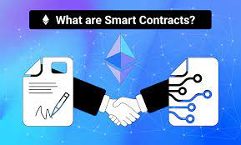
What is Smart Contract
Smart Contract is a self-executing program stored on Blockchain based platform that automates the actions required in an agreement or a contract.
Examples :
If exporters goods arrive on time and good condition, then payment is triggered.
Group of 1000 people buying 20 rental properties and receiving rental yield.

Slide 3
What is Smart Contract Audit
A smart contract audit is the detailed analysis of programmed agreements in a smart contract consisting of functions and data that get automatically executed whenever a network tries to access it for a transaction requested by a user and the terms pre-set by both parties are successfully met.

Slide 4
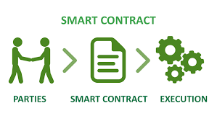
Why Audit Smart Contracts
Smart contract are public .
Smart contract should be audited in early stage to identify low key issues.
Achieving regulatory Compliance.
Auditing is must in Web3 because it is immutable.
Protocol level auditing is best practice.
To avoid high cost of failure.
No guarantee

Slide 5
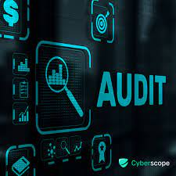
How Audit works
SWC(Smart Contract Weakness Classification ) Registry offer a complete catalogue of known vulnerabilities and anti-patterns proposed in EIP(Ethereum Improvement Proposal) -1470.
Smart Contract Security Verification Standard ( SCSVS)
Audit Report generated with vulnerability details and recorded risk.

Slide 6
Auditing Tools
Automatic tools can usually be integrated with development environment.
Some task specific tools-
Ethlint-Style and security
MythX- Static & Dynamic Analysis
Slither-Static Analysis tool
SafeScan- AML & KYC verification tool for wallets.
CyberScan –Cryptocurrency token verification
ZeppelinOS - Comprehensive platform for Manage, Develop, Audit & Deploy SC on Ethereum blockchain.

Slide 7

ChatGPT and smart Contract Audit
ChatGPT can do parts of audit like
Reentrancy attack
Integer Overflows/ underflows
Unchecked return values
Unprotected functions
But misses
Project specific logic
Inaccurate math logic and statistical models
Irregularities in intended design and implementation

Slide 8
Q&A
Chandra’s contact:
Email: Verma.Chandra@gmail.com
LinkedIn: www.linkedin.com/in/chandraverma

